Slide 1
Videos Lectures to Enhance Student Learning and Performance in an Online Elementary Statistics Course
Cathy M. Frey, Professor of Mathematics
Norwich University

Slide 2
Abstract
Our Elementary statistics course covers the study of frequency distributions, averages and standard deviations, normal curve, probability, decision-making, sampling techniques, testing hypotheses, students-t -distributions, correlation and linear regression. We offer multiple sections of this course online each semester in our adult degree completion programs. This study compares student performance for two groups over six terms with the same course content, assignments and exams. One group also had benefit of video lectures to supplement the lecture notes in the course.

Slide 3
Elementary Statistics
A course that covers the study of frequency distributions, averages and standard deviations, normal curve, probability, decision-making, sampling techniques, testing hypotheses, students-t -distributions, correlation and linear regression. This course is valuable for those who plan to enter teaching. Prerequisite: A college level mathematics course or equivalent as determined by departmental placement testing.

Slide 4
The Students
The Bachelor of Science in Strategic Studies and Defense Analysis (BSSSDA) is a degree-completion program designed to build upon the military education and experience of Special Operations Forces (SOF) in the U.S. Army, Navy, Air Force, and Marine Corps. The BSSSDA program of study fulfills general education competencies needed to complete the bachelor’s degree while developing a soldier’s knowledge in vital areas such as sociology-anthropology, geography, cultural awareness, regional politics, and international conflict. The program is open to those who are active duty or retired from the U.S. Army Special Operations Forces, including reserve and National Guard components, as well as to other service members who are assigned to Special Operations Units.

Slide 5
Structure of the course
This is an eight week 3 credit course including:
Weekly lecture notes
Testing concept problems
Weekly discussion
weekly assignments
Weekly quizzes
Multiple choice Midterm exam
final exam including multiple choice as well as long answer questions
The course content is developed by a course instructor and all instructors use the same content.
The only difference between the content in the treatment group and the control group is the introduction of video lectures to supplement the lecture notes.

Slide 6
The study
Control group
69 students
3 instructors
4 sections of the course
Treatment group
162 students
4 instructors
9 sections of the course

Slide 7
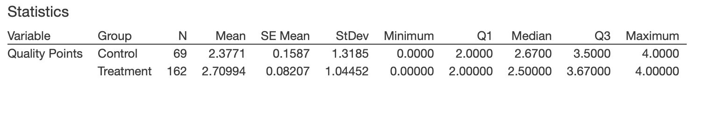
Descriptive statistics of quality points by group

Slide 9
The results
Analysis of the student performance with the video lectures showed
a significant (two sample t test, t=-1.86, p-value = 0.0326) increase in the average grade from 2.38 to 2.71 quality points.
as well as a significant decrease (two sample proportion test, z=2.83, p-value = 0.0010) in the failure/withdrawal rate, from 16.4% to 4.3%.
And a significant decrease (Levene test, test statistic =3.76, p-value =0.0534) in the standard deviation between the two groups.

Slide 10
Questions?

Slide 11
Thank you
I wish to acknowledge the support provided by the faculty development program at Norwich University in the form of travel funds to attend this conference.
Contact Info: Frey@Norwich.edu

